Slide 1




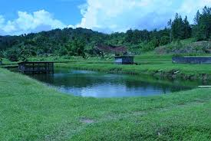
Improving Community Health-Nutrition Linkages through Solar Energy Based Fish and Crop Integrated Value Chains (ICH-LIEBE-FISCH)

Slide 2



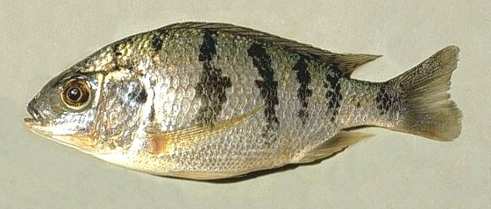
INTRODUCTION
LUANAR, QUALivES, IFFNT in collaboration with Germany partners are to conduct a 3 year research for development project called ICH-LIEBE-FISCH.

Slide 3

ICH-LIEBE-FISCH
Main Objective
To improve health, nutrition and incomes of smallholder farmer communities through collaborative implementation of a sustainable aquaculture practice for the endemic finfish species Oreochromis karongae in combination with crop production in a closed nutrient cycle and with reduce water usage.

Slide 4

Specific Objectives
To steadily increase the supply O. karongae (Chambo) fingerlings to fish farmers
To sustainably use water resources through multiple use in fish and crop production
To diversify crop production, especially of indigenous vegetables.
To disseminate technical and production expertise in fingerling production and use of IAA systems
5. To Enhance socio-economic status of farmers in rural areas through dissemination of knowledge and strengthening of competiveness through networking.
6. To Ameliorate food and income security for smallholder farmers in rural areas.
7. To Improve health status of rural communities

Slide 5
Research Areas
The Project will be implemented in two districts; Mchinji and Nkhotakota
In Nkhotakota the project will concentrate its activities in
  Ntosa EPA (Benga section)
This section has been selected due to large number of active fish farmers.

Slide 6
Target beneficiaries
The Project will work with selected fish farming communities
  Individuals, groups , clubs

Slide 7
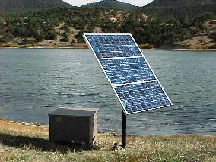
Activities of the project
Project will start with a crosscutting baseline study that will;
  look at the current status of Aquaculture;
  Assess Women and Child Health and nutrition
  Capture the Knowledge of communities on IAA systems
Fish Production:
Fish production
Vegetable production
Solar powered fish hatcheries.

Slide 8
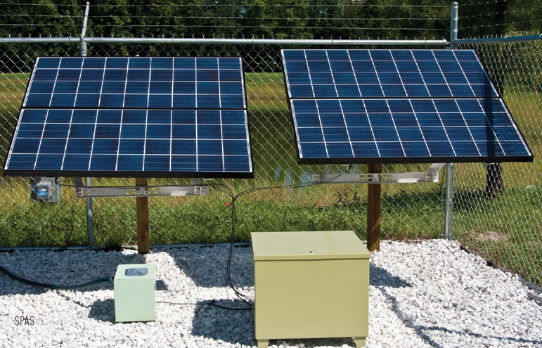

Slide 9
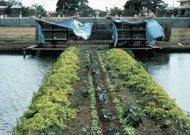

Slide 10
Activities of the project
Product Development
Value addition

Slide 11
Activities of the project
Establishment of Care groups
Impact Evaluation
End line Survey

Slide 12
Community Outreach & Benefits
Through the Project the selected communities will benefit
  Capacity building through training in fish production
  Exposure to markets for their products
  Increased access to nutritious food stuff in the communities
  Formation and support of innovative platforms

Slide 13
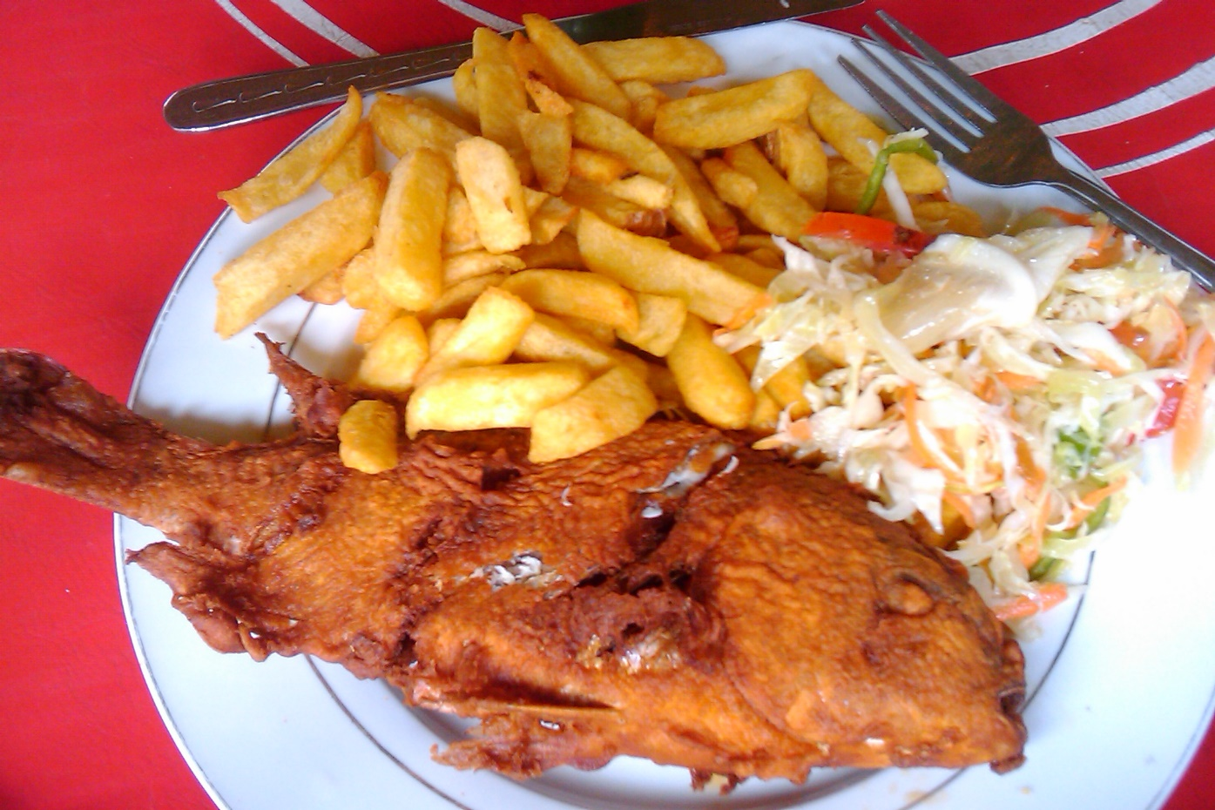
End of Presentation
Thank you

