Slide 1




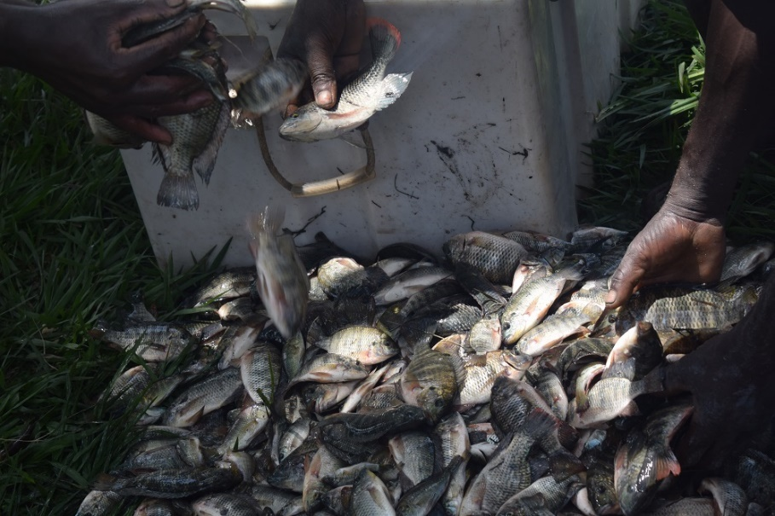
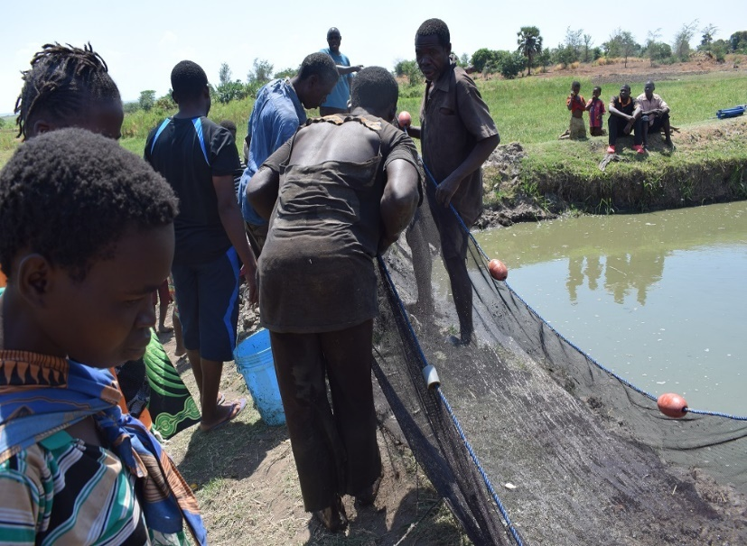
Improving Community Health-Nutrition Linkages through Solar Energy Based Fish and Crop Integrated Value Chains (ICH-LIEBE-FISCH)

Slide 2



INTRODUCTION
LUANAR, QUALivES, IFFNT implemented a number of activities that were planned for Year 2 of the project in 2017.
The activities implemented are:
1. Farmer Consultation Meetings
2. IAA and hybrid Grow out Management
3. Fish stocking and Feed preparation
4. Monitoring and Feed Delivery
5. Food processing, fish harvesting and marketing Training
6. Fish harvesting

Slide 3
FARMER CONSULTATION AND POND INSPECTION
Farmer consultation meetings were conducted on 1st and 2nd May 2017 in Nkhotakota and Mchinji districts.
The objectives of the trips were to:
1. Consult farmers about different vegetable varieties they would have liked to integrate with fish farming
2. Inspect ponds that were non stocked in order to find out the total number of fingerlings required to stock the ponds in the project site.
RESULTS
Rape, Mustard, Amaranths, Chinese Cabbage, Pumpkin leaf vegetables were some of the vegetable varieties that were recommended by farmers.
Six ponds belonging to Chikondi Fish Club, Tikondane Fish Club and Ntawa Fish Club were non stocked in Mchinji.

Slide 4


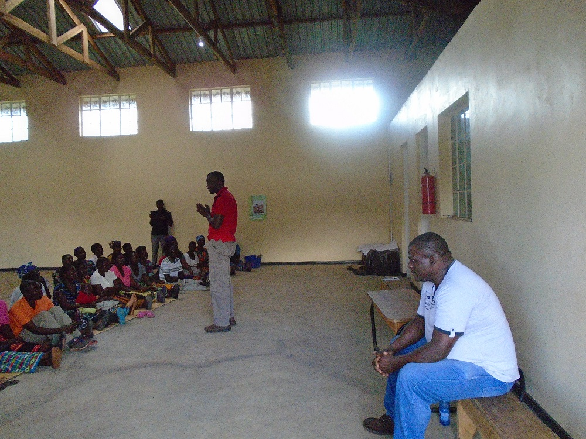
FARMER CONSULTATION CONT…
In addition to the 6 ponds, two individual farmers reported to have non stocked ponds in Mchinji.
A total of 16 ponds were non stocked in Nkhotakota belonging to 9 fish clubs in the district.
It was established during this trip that clubs were not practicing Fish and Vegetables integration.

Slide 5
Integrated Agriculture-Aquaculture and Grow out Management Training
IAA training was conducted from 8th : 11th May 2017 in Nkhotakota and Mchinji Districts.
The Main objective of the training was to equip fish farmers with knowledge intense IAA technology and pond management.
RESULTS
145 fish farmers from 11 fish clubs and 5 non fish farmers (Nkhotakota pottery) were trained in Nkhotakota.
140 fish farmers from 4 fish clubs were trained in Mchinji.
The training was successful as it met all its objectives which included describing the synergetic linkages among arable crops, vegetables, livestock and fish farming, discussing the vegetable – fish IAA design under study, equipping fish farmers with attitude, skills and knowledge in general pond management.

Slide 6
FISH STOCKING AND FEED FORMULATION
A total of 26,515 fingerlings with average size of 10g were distributed to 7 Fish Clubs in Nkhotakota and 3 Fish Clubs and 2 individual farmers in Mchinji.
Scarcity of Oreochromis karongae (4 ponds) fingerlings forced project team to stock more ponds with Oreochromis shiranus (12 ponds).
Four vegetable varieties; Amaranths, Chinese cabbage, Pumpkin leaf vegetables and Rape were distributed to the farmers.

Slide 7
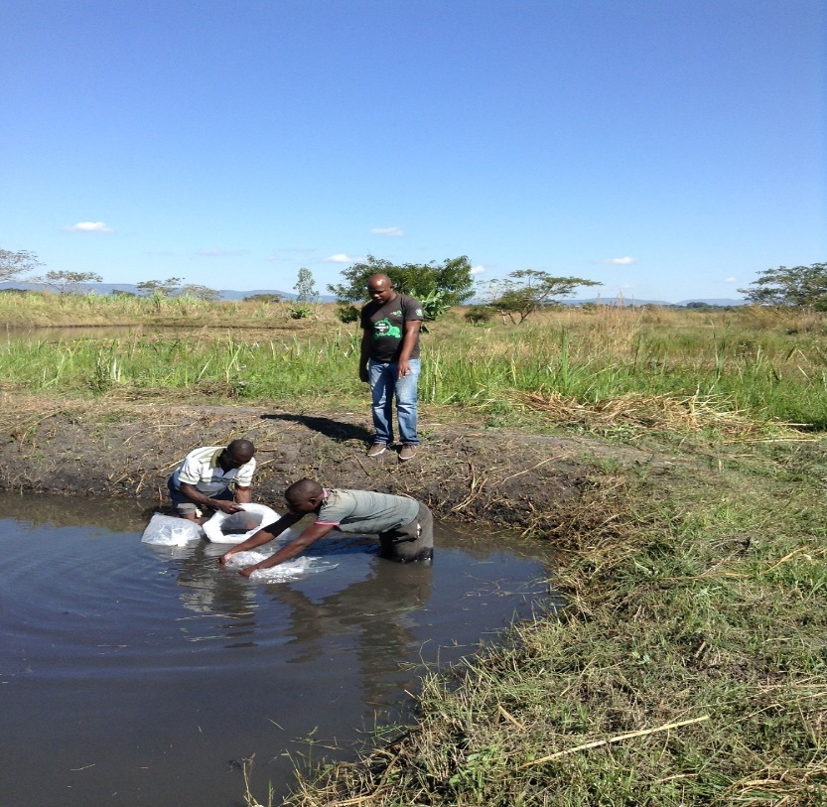
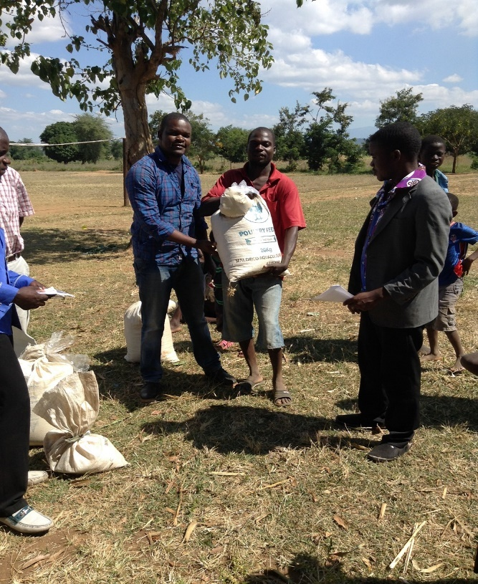
FISH STOCKING AND FEED FORMULATION Cont.…………….
  Fish feeds of 30% crude protein level were formulated and all the clubs received the same feed in proportion to 5% body weight distributed to two feeding regimes .

Slide 8
MONITORING AND FEED DELIVERY
Three monitoring field trips (JUNE,JULY,AUGUST) were done with the following objectives:
Monitor general management of the fish ponds
Monitor growth of fish and vegetables
Distribute feed and feed rations
Due to insufficient funds allocated to monitoring and evaluation the project team failed to go for monitoring for the month of September.

Slide 9
Summary of fish growth of all the clubs in Nkhotakota District Over Three Months Period

Slide 10
Summary of fish growth of all the clubs in Mchinji District Over Three Months Period

Slide 11
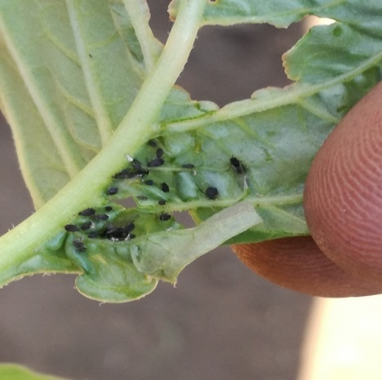
MONITORING RESULTS
A total of four ponds (both in Nkhotakota and Mchinji) started drying up.
The idea of bringing in a horticulturist came in a bit too late as such no data was collected on growth performance of vegetables.
Farmers were not trained in vegetable production as such most of the clubs failed to produce vegetables successfully.
Vegetables were attacked by pests and diseases because there was no allocated budget for pesticides.
Oreochromis shiranus was observed to grow faster than Oreochromis karongae.

Slide 12
FOOD PROCESSING, FISH HARVESTING AND MARKERTING TRAINING
The trainings were conducted in Nkhotakota from 6th -10th November and in Mchinji from 11th - 15th November 2017 with the following objectives:
To establish and revamp care groups in the project sites.
To train farmers in fish product development.
To conduct sensory evaluation of the developed fish products.
To equip communities with basic nutrition and complimentary feeding knowledge.
To train fish farmers in fish harvesting and post harvesting handling.
To train communities in marketing of fish and fish based products

Slide 13
CARE GROUP ESTABLISHMENT
The criteria for membership of the care groups is either pregnant women or lactating mothers.
In Nkhotakota, the focus of the training team was on revamping already existing care groups that have been working with Nkhotakota AIDS Support Organization in the surrounding villages of Masakatira, Chijere, Mkonda and Maluzi.
New care groups were established where they did not exist in Njolo and Sinoya.
In Mchinji the training team refurbished already existing care groups from all the three fish clubs (Tikondane, Chikondi and Ntawa).

Slide 14
PRODUCT DEVELOPMENT AND SENSORY EVALUATION
A total of 72 women from the revamped and established care groups were trained in a wide number of nutrition topics such as the six food groups, importance of dietary diversification, and principles of infant and child feeding.
In addition to the women from care groups, the training also involved fish clubs chairpersons (16 Men) and primary and secondary school students (3) and their patrons (3)
The attendants were trained how to make Maize, fish, vegetable porridge and Cassava, fish, vegetable porridge that are aimed to improve the nutrition status of infants and young children (under 2 years).
They were also taught how to make fish sausage, fish balls and fish samosa that are aimed to improve the nutrition status of the whole family and their income.

Slide 15
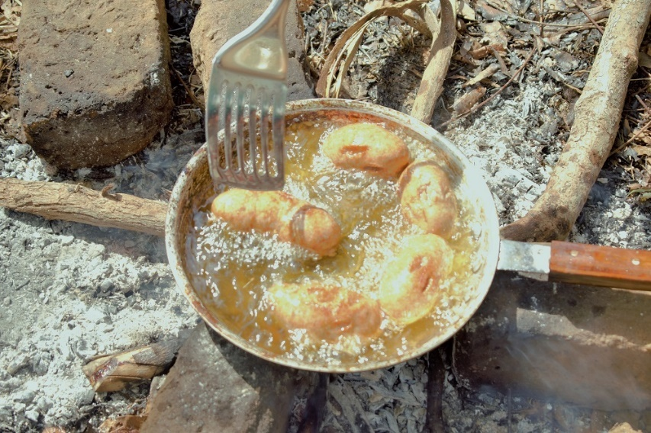
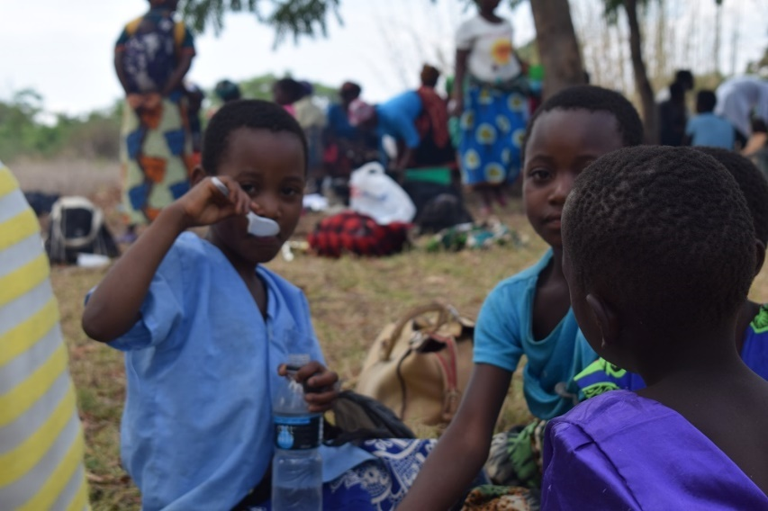
PRODUCT DEVELOPMENT AND SENSORY EVALUATION Conti……
Participants were asked to test the products based on these sensory attributes: color, smell, taste and texture.

Slide 16
FISH HARVESTING, POST HARVESTING HANDLING AND MARKERTING TRAINING
Ten members from each fish club under the project were trained in fish harvesting techniques and post harvest handling methods
In addition, together with the representatives from care groups they were trained on basic principles of marketing and record keeping (simple accounting).
The fish farmers were tasked to find market for their fish before actual harvesting

Slide 17
FOCUS GROUP DISCUSSIONS ; CHALLENGES FACED BY FARMERS
Vegetables were attacked by pests and diseases
Some ponds dried up
They did not have fertilizer for the vegetables
They lacked horticultural extension services from the beginning.
In adequate equipment such as canes, holes, shovels and wheelbarrows.
Some clubs especially in Nkhotakota expressed that they need to be paid for working on the ponds or be supported to start small businesses.
Hunger more especially in Nkhotakota forced them to not fully focus on fish farming because they spent much of their time looking for ganyu (piece work).
Some clubs reported that some of their members refuse to be active in running day to day activities in the club but want to only participate in workshops and harvesting time.

Slide 18
FISH HARVESTING
After growing the fish for 6 months, a field visit was organized to the respective project sites for harvesting.
Nkhotakota
 | POND NAME - MEAN WEIGHT (g)
MONTH | Sinoya | Njolo | Teen Mission | Masakatira | Maluzi | Chijere | Mkonda | Mkonda 2
May | 10 | 10 | 10 | 10 | 10 | 10 | 10 | 10
Jun | 27.87 | NA | 16.14 | 17.29 | 25.71 | 24.72 | 12.58 | 20.21
Jul | 36.98 | 51.99 | 20.5 | 21.07 | 39.86 | 45.24 | 21.31 | 25.58
Aug | 57.24 | 94.68 | 44 | 35.11 | 44.33 | 53.34 | 36.22 | 37.26
Nov | 62.5 | 169.6 | 30.97 | 44.8 | NA* | NA* | NA* | NA*
Mean Weight Gain | 52.5 | 159.6 | 20.97 | 34.8 | NA | NA | NA | NA
* Pond dried due high tempratures

Slide 19
FISH HARVESTING
Total biomass harvested per pond in Nkhotakota district
 | POND NAME - TOTAL BIOMASS(kg)
POND Name | Sinoya | Njolo | Teen Mission | Masakatira | Maluzi | Chijere | Mkonda | Mkonda 2
Number of fish stocked | 1500 | 315 | 500 | 750 | 1500 | 2000 | 1000 | 1500
Harvest of target fish (kg) | 6.8 | 5.8 | 4.7 | 3.9 | 0 | 0 | 0 | 0
Harvest of wild fish (kg) | 6 | 0 | 0 | 0 | 0 | 0 | 0 | 0
Total biomass harvested per Pond (kg) | 12.8 | 5.8 | 4.7 | 3.9 | 0 | 0 | 0 | 0
Total biomass harvested per district (kg) | 27.2

Slide 20
FISH HARVESTING
Mean Weight Mchinji
 | POND NAME - MEAN WEIGHT (g)
MONTH | Jamikaeli | Tikondane 2 | Tikondane 1 | Tikondane 3 | Chikondi 2 | Chikondi 1 | Jefita | Ntawa
May | 10 | 10 | 10 | 10 | 10 | 10 | 10 | 10
June | 18.76 | 19.86 | 22.34 | 17.26 | 16.68 | 17.7 | 19.96 | 14.71
July | 24.76 | 28.59 | 41.79 | 29.14 | 39.36 | 20.72 | 58.65 | 30.86
Aug | 32.06 | 33.62 | 42.34 | 55.4 | 72.24 | 33.63 | 61.04 | 52.64
Nov | 58.8 | 56.2 | 94 | 93.8 | 81.8 | 75.6 | 100 | 61.5
MEAN WEIGHT GAIN | 48.8 | 46.20 | 84.00 | 83.8 | 71.8 | 65.6 | 90 | 51.5

Slide 21
FISH HARVESTING
Total biomass harvested per pond in Mchinji district
POND NAME | Jamikaeli | Tikondane 2 | Tikondane 1 | Tikondane 3 | Chikondi 2 | Chikondi 1 | Jefter | Ntawa
Number of fish stocked | 1000 | 2500 | 5000 | 1200 | 1750 | 1000 | 1250 | 3750
Harvest of target fish (kg) | 1.7 | 11.04 | 42.21 | 44.4 | 20.38 | 6.09 | 8 | 10.5
Harvest of wild fish (kg) | 0 | 3.16 | 6.28 | 9 | 4.3 | 0 | 0 | 0
Total biomass harvested per Pond (kg) | 1.7 | 14.2 | 48.49 | 53.4 | 24.68 | 6.09 | 8 | 10.5
Total biomass harvested per district (kg) | 167.06

Slide 22
FISH HARVESTING
Overall results are showing that Mchinji harvested more than Nkhotakota district.
In Nkhotakota only four ponds out of eight were harvested. The remaining four had dried up due to high temperatures and this was considered as a complete loss.
Ponds in Nkhotakota are near Lake Malawi as such clubs in these areas showed less commitment in managing their ponds since the lake acts like an alternative source of livelihood.
Unlike Nkhotakota, clubs in Mchinji are more organized when it comes to pond management and feeding.
Productivity of Oreochromis karongae was relatively low due to problems in water quality since it grows well in waters of high quality.

Slide 23
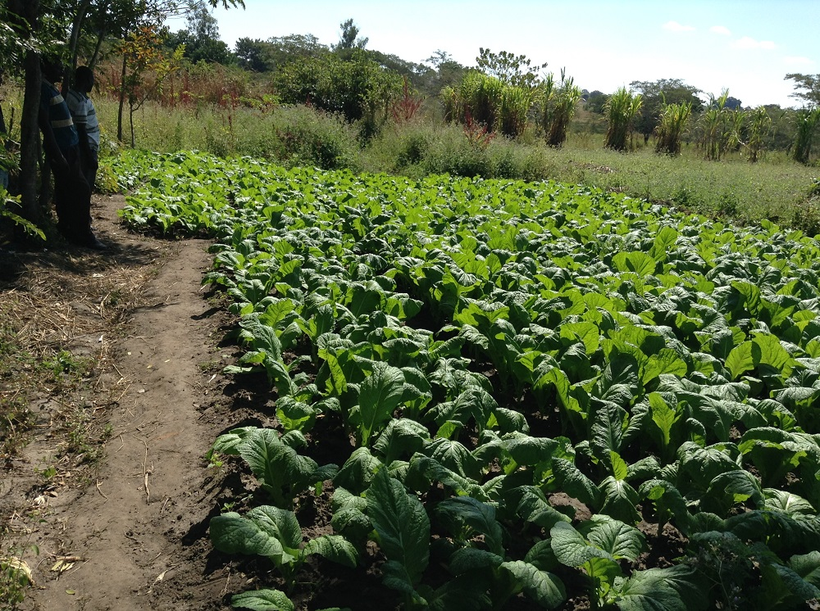
END OF PRESENTATION!!!!!
THANK YOU

