Slide 1
Masamalidwe ansomba kuti zikule bwino
Okupasilani
ndine
Martha Alufeyo

Slide 2
zinthu zoyenera kuziwa tisanayambe kuweta nsomba
Kuphwetsa damu
Kukhala ndi madzi oyenera mu damu
Kuika nsomba za mbewu mudamu
Kuthira layimu
Kuthira manyowa
Kapangidwe ka chakudya cha nsomba
kudyetsera nsomba moyenera
Kuteteza nsoma za mu damu ku zilombo
Kukolola nsomba moyenera

Slide 3
Ubwino wophwetsa damu
Kupha madzira a tizilombo towononga nsomba
Kuchosa nsomba zosalira
Kuthandiza kuwolerana kwa manyowa

Slide 4
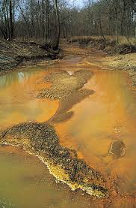
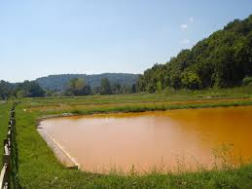

Slide 5
kuthira layimu/phulusa
Layimu athiridwe patasala masabata awiri kuti tiyike nsomba mu damu
Amachosa asidi wa munthaka yemwe amaononga nsomba
Amathandiza kuti manyowa agwire bwino ntchito
Amathandiza kupewa tizilombo towononga nsomba

Slide 6
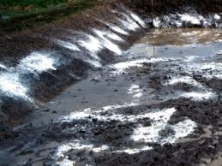
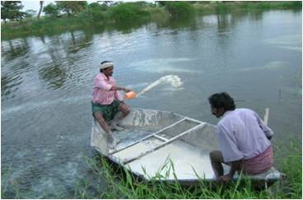
Kuthira lime

Slide 7
Ubwino wothira manyowa mu damu
amachulusa chonde cha nthaka ya mu damu
Amachulusa zokolola
Fetereza wa NPK amathanso kugwirisidwa ntchito
amathandizira kukulisa zomera za mu damu zomwe ndi zakudya za nsomba
Manyowanso ndi chakudya cha nsomba

Slide 8
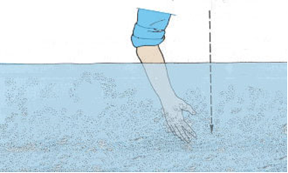
Kuziwa ngati madzi a mu damu mwathu akufunika manyowa
Njira yoyamba
Ngati tikuona songa za zala zathu
titaviika mkono wathu mudamu
ndiye kuti madzi a mu damu
mwathu akufunika manyowa

Slide 9
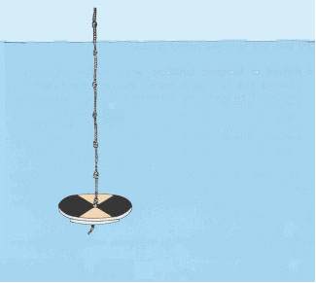
Kuziwa ngati madzi amu damu mwathu akufunika manyowa
Njira yachiwiri
Seki disiki
Mapangidwe
Lata
Chingwe
Penti woyera ndi wokuda

Slide 10
Mulingo wamanyowa wothira mu damu
1000kg/ha/week
1ha = 10000
10 X 20= 200
200 X 1000kg = 200 000
200 000/10 000 = 20kg

Slide 11
Mulingo wa fetereza othira mu damu
23:21:0+4S
Urea
Ammonia sulphate
DAP
CAN
Kukula kwa damu (m²) | Mlingo wa pasabata (paketi ya Chibuku)
200 | ¼
400 | ½
800 | ¾
1,000 | 1¾

Slide 12
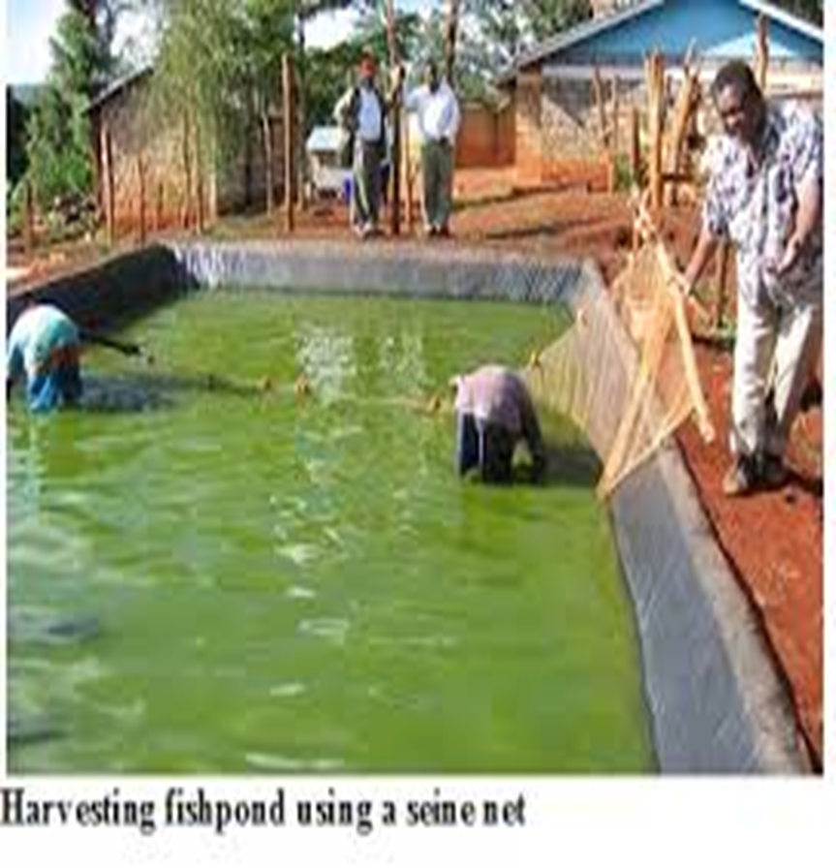
Madzi oyenera mu damu
Madzi a mu damu sayenera kukhala oyera ngati okumwa
Madzi sayeneranso kukhala okuda kwambiri
Madzi mudamu sakuyenera kuchepera 1mita
Madzi abwino amaoneka obiriwira (green)

Slide 13
Kuika nsomba mu damu
Nsomba 5/m2
Nsomba zimayenera kuikidwa mu damu mmamawa kapena madzulo
Zokudya za nsomba zomwe alimi amaziziwa

Slide 14
Mapangidwe achakudya cha nsomba
Zofunika
Soya
Deya (gaga)
Zonyenyeka za nsomba (ngati zingapezeke)
Mapangidwe
Kukazinga soya
Kugaya soya
Zitini zitatu za ufa wa soya (30 %)
Zitini zisanu ndi ziwiri za ufa wa gaga (70%)
Tisakaniza ufa wa soya ndi gaga
Tithira madzi
Tidifinya pa lata lobooola
Tiyanika pa dzuwa

Slide 15
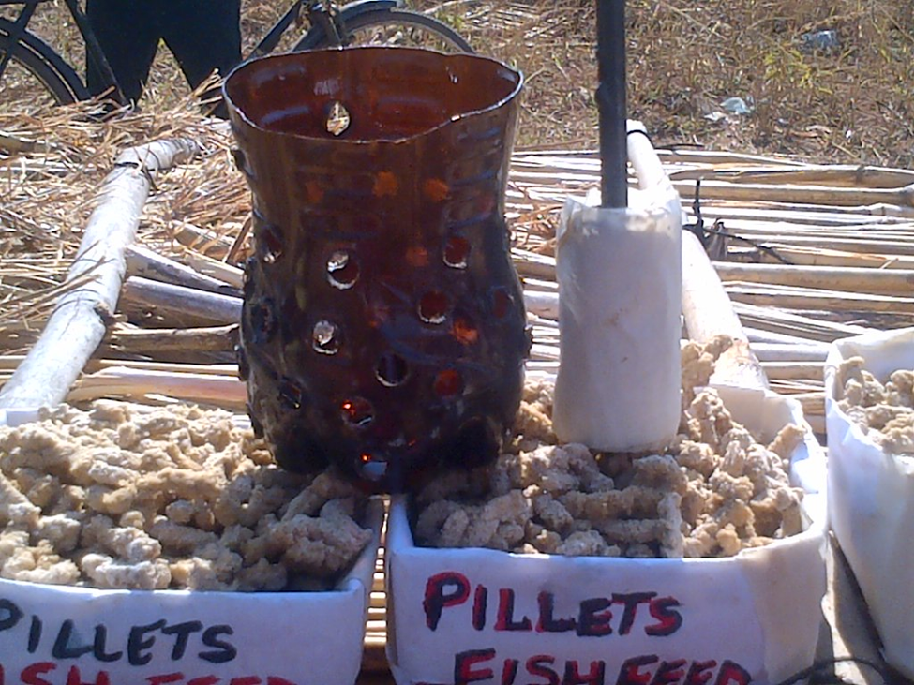
Mapangidwe a chakudya cha nsomba
Zipangizo
Lata loboola ndi mnsomali
Botolo loboola

Slide 16
Madyetsedwe ansomba oyenera
Nsoma zimadyetsedwa tsiku ndi tsiku pa nthawi imodzimodzi
Kudyetsera mmawa ndi madzulo
Kuchuluka kwa chakudza kumatengera makulidwe nsomba

Slide 17
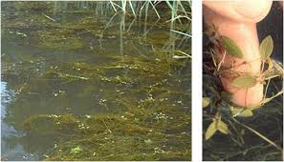
Zinthu zina zoyenera kudziwa
Malo ozungulira damu ayenera kutchetchedwa
Damu siliyenera kukhala pa mthuzi (pansi pa mitengo)
Udzu omera mudamu umayenera kuchotsedwa

Slide 18
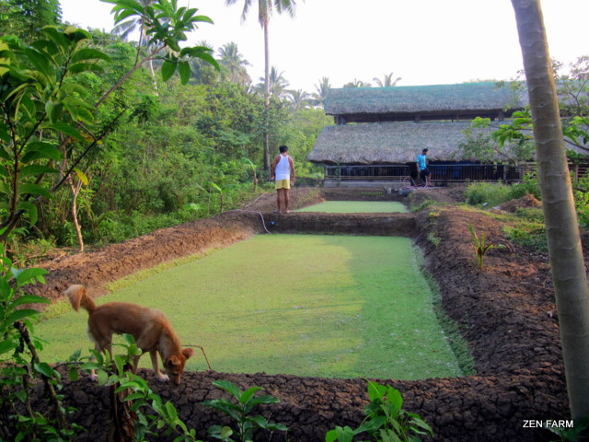
Udzu omera mu damu

Slide 19
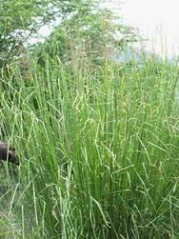
Udzu omera mu damu

Slide 20
Kuipa kwa udzu omera mu damu
Umatchinga nsomba ku dzuwa dzuwa
Umatulusa mpweya oyipa
Umapangisa kukolola nsomba kukhala kovuta
Umaononga chonde cha mu damu

Slide 21
Kuteteza damu lathu ku zilombo monga
zilombo | matetezedwe
katumbu | Mpanda/matching/nsampha
Njoka | Nsampha/kutchetcha tchire
Ng’azi | Kutchetha tchire/nsampha
nkhanu | Kukoka ndi ukonde
achule | Kukoka ndi ukonde
Nantchengwa(katawa) | Kuika zingwe pa damu

Slide 22
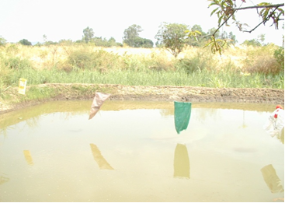
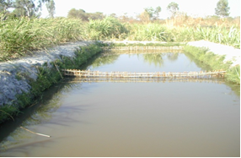
Kuteteza damu ku zilombo
Kuteteza ku Mbalame
Kuteteza ku Katumbu

Slide 23

Makololedwe ansomba
Nsomba zimakololedwa mu njira zosiyanasiyana
  Kukumba kadzenje mu damu ndi kuphwesa madzi kuti nsomba zonse zilowe pakadzenjepo
  Kuphwesa madzi pang’ono nkugwira nsomba ndi ukonde
  Kugwiritsa nchito pampu

Slide 24
ZIKOMO

